Slide 1





Applied Machine Learning for opening a new pizzeria in Naples
Riccardi Luca, Data Analyst @ Mopar (F.C.A.)

Slide 2
Introduction
Nowadays, opening a new activity is an investment that needs a deep study in order to not lose money. In this presentation, we will show a study focused on fininding the optimal place where opening a new pizzeria in the city of Naples, Italy.
This study has been done as Capstone project for the Data Science specialization by IBM. Report and notebook can be found on my GitHub page.
GitHub Repository: https://github.com/zick094/ds_capstone
Report: https://github.com/zick094/ds_capstone/blob/master/Report.md
Notebook: https://github.com/zick094/ds_capstone/blob/master/Naples%20Neighborhoods.ipynb
<number>

Slide 3



1. Pizza and Naples
An historic combination

Slide 4
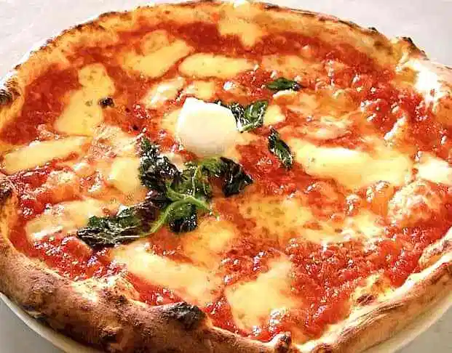
Why pizza in Naples?
One of the most popular meal in the world. Someone says that it comes from Turkey, others from Italy. Pizza has radically changed the world, in particular in Naples, the city considered as the birthplace of that disc of dough with tomato souce, mozarella and fresh basil.
On the side you can see a beatuful pizza margherita with fresh basil and a small mozzarella on top.
<number>

Slide 5

2. Overview of the city

Slide 6
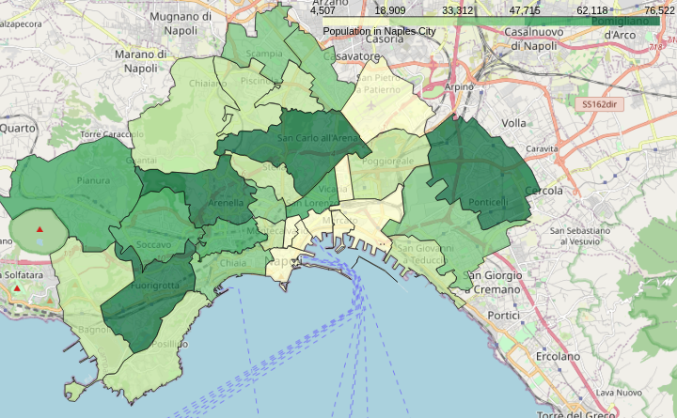
Why pizza in Naples?
Naples is the the third city in Italy for number of people, with almost one million of residents. It is the capital of Campania region and it is one of the most important cultural center all over the Italy. The city is mainly divided in 10 municipalities, with in total 30 boroughs.
<number>

Slide 7
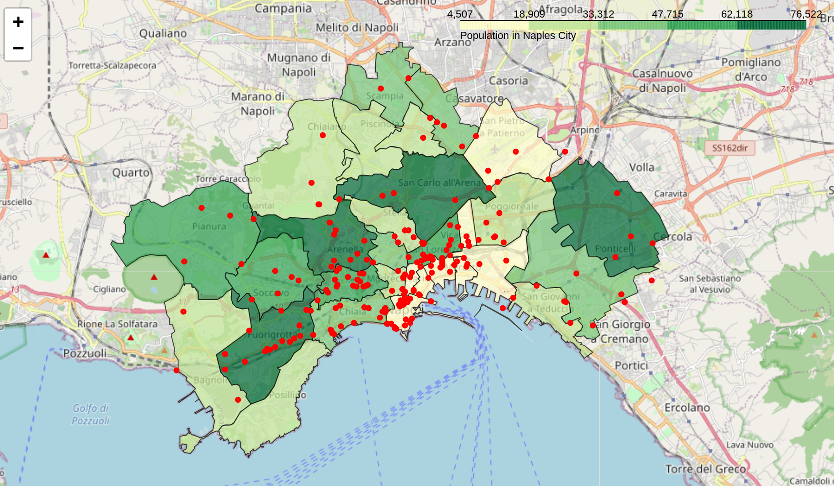
Why pizza in Naples?
Pizzeria are very popular in the city of Naples. You can sit in, or take-away a pizza and eat it on the seafront. There is also a special version so called wallet-pizza, that is a small folded up version.
On the side you find recognized pizza using Foursquare API
<number>

Slide 8
3. Methodology

Slide 9







K-means for optimal places
We will use k-means algorithm to find the best places where it is worth for opening a new pizzeria. We are going to clusterize the pizzeria in clusters that share similarities on nearby venues.
<number>

Slide 10
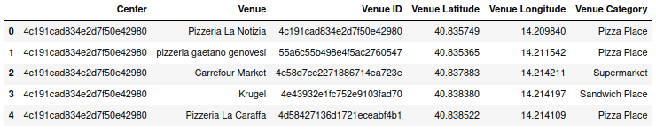
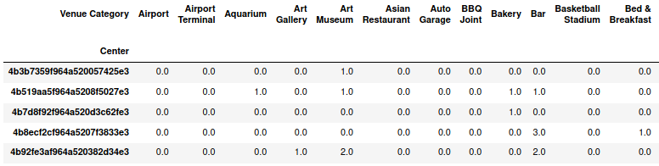
Feature engineering
One hot encoding is performed as pre-processing of data.
<number>

Slide 11
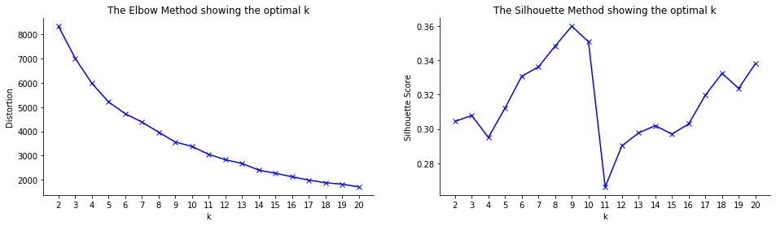
Model selection
The parameter k is unknown, so both elbow and silhouette method are shown.
Best k is 9 since maximize silhouette score (elbow method does not give a clear indication).
<number>

Slide 12
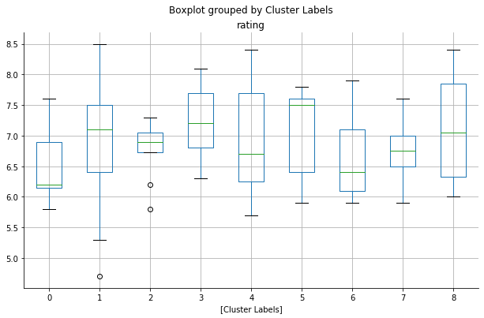
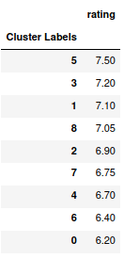
Median rating for cluster
We can build a cluster rating, for example using median value
Accordingly with our criteria, best pizzeria are in cluster 5
<number>

Slide 13
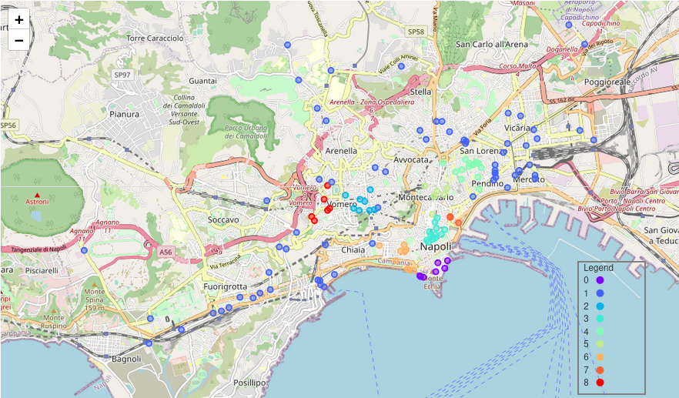
Cluster map
Montecalvario have the highest median rating.
<number>

Slide 14
Prediction
We have now built the model that is capable of clusterize venues based on the neighborhood similarity. Next steps are:
Sample point from borough
Explore nearby venues
Classify with previously trained model
<number>

Slide 15
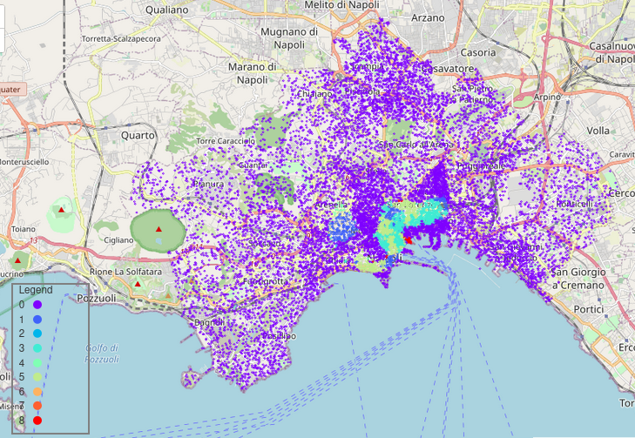
Results
Accordingly to the algorithm, cluster 5 areas are the best where opening a new pizzeria
<number>

Slide 16
Conclusion

Slide 17
Power of ML
Machine Learning can be applied in various field.
In this report we gave an example of application in finding the optimal place based on acquired experience on active pizzeria.
This can be generalized for opening bar, pub and also restaurants.
<number>

Slide 18

Thanks!
Any questions?
You can find me at:
luca.riccardi@live.it
<number>

